Slide 1

PROJECT
PREDICT LIVER DISEASE
Guided By – Varun Sir.

Slide 2

Team Member’s
Ms. Anjali Mahajan.
Ms. Shivani Dogne.
Ms. Mamta Patil.
Mr. Amey Kumbhar.
Mr. Kunal Shinde.
Mr. Om Gorantiwar.

Slide 3

BUSINESS OBJECTIVE
The variable to be predicted is categorical
(no disease, suspect disease, hepatitis c, fibrosis, cirrhosis).
Therefore, this is a classification project.

Slide 4

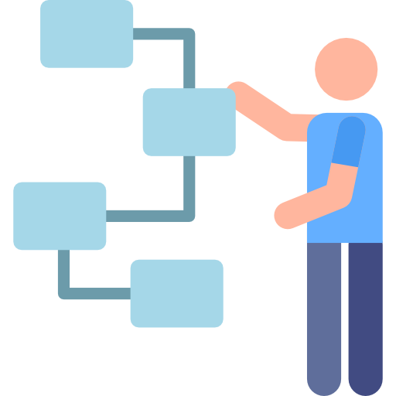
Project Flow-
EDA
Model building
Model Evaluation
Deployment
Final Presentation

Slide 5
DATA DESCRIPTION
The number of instances (rows) in the data set is 615, and the number of variables (columns) is 13. Nearly all input variables are numeric-valued except one, Sex, which is binary, and most of them represent measurements from blood and urine analysis. The following list summarizes the variables information:
Category
Age
Sex
Albumin
alkaline_phosphatase
alanine_aminotransferase
aspartate_aminotransferase
Bilirubin
Cholinesterase
Cholesterol
Creatinina
gamma_glutamyl_transferase
protein

Slide 6
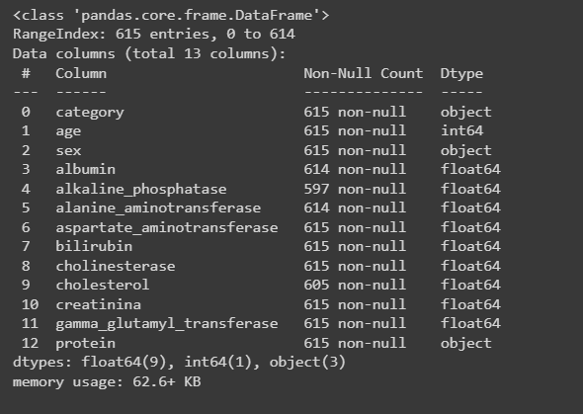
Data.info()

Slide 7
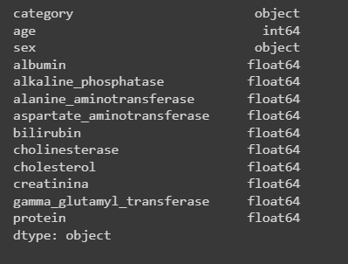
Data.types()

Slide 8
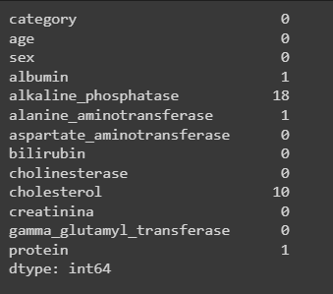
Data Cleaning
Data.isnull()

Slide 9
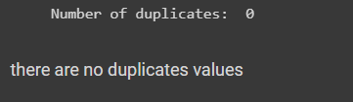
Checking for duplicates values
Data.duplicates()

Slide 10
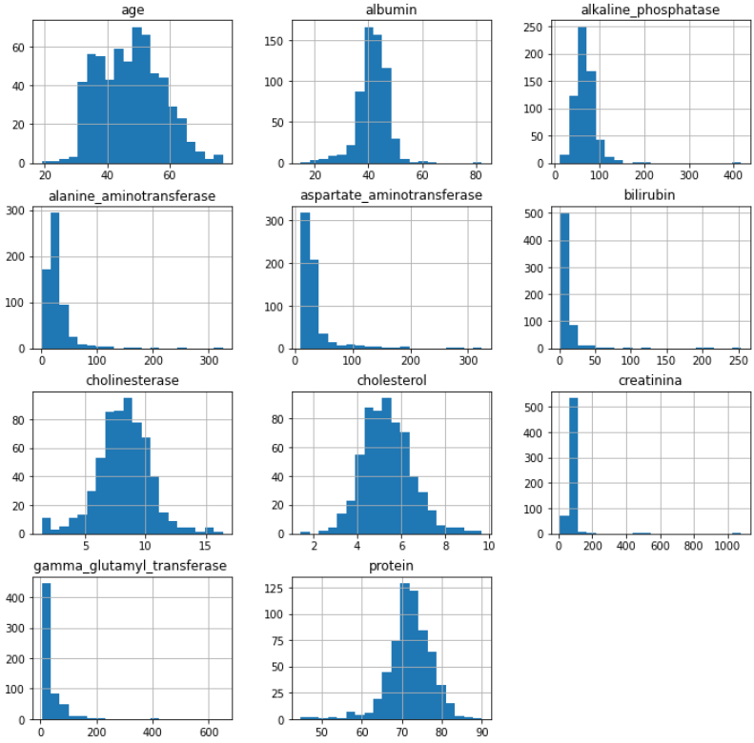
Visualization
Data.hist()

Slide 11
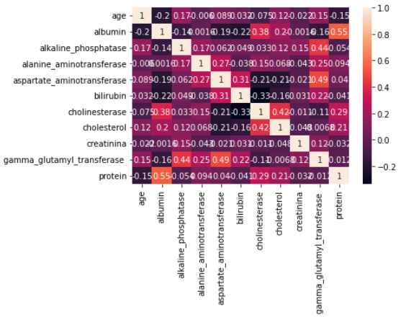
Correlation Matrix
sns.heatmap()

Slide 12
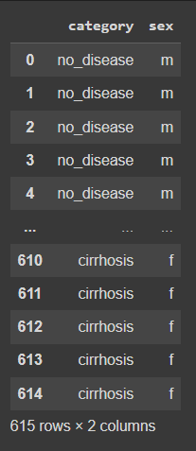
Separating of non-numerical
and numerical values
data.select.d_types()
*Selecting numerical features

Slide 13
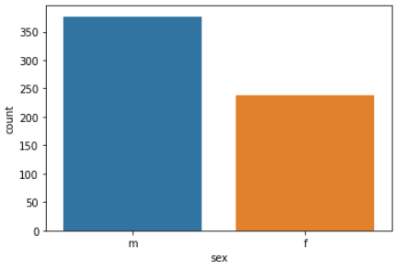
Distribution of target variables
sns.countplot()

Slide 14
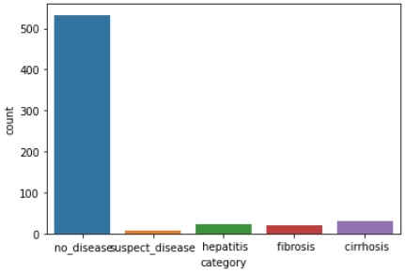
Distribution of target variables
sns.countplot()

Slide 15
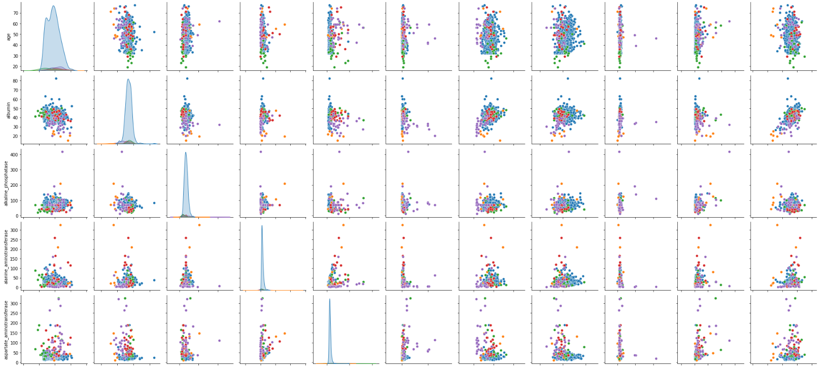
Multivariate analysis
sns.pairplot()

Slide 16
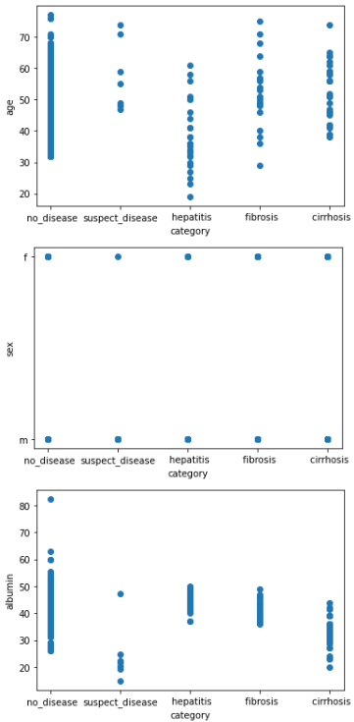
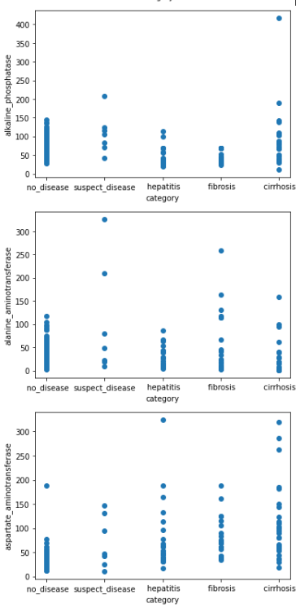
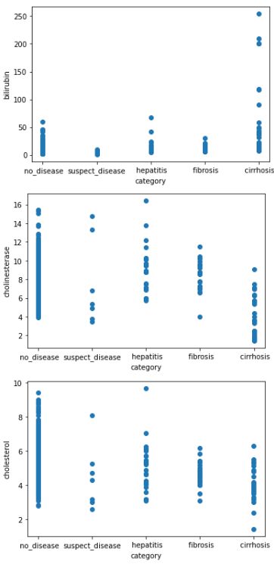
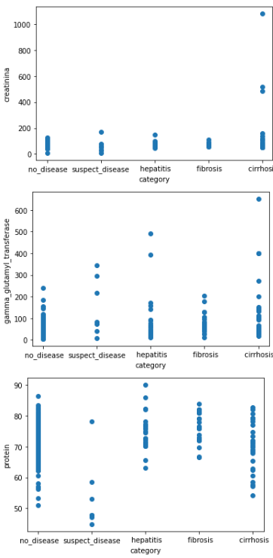
Creating multiple scatterplot
plt.scatter()

Slide 17
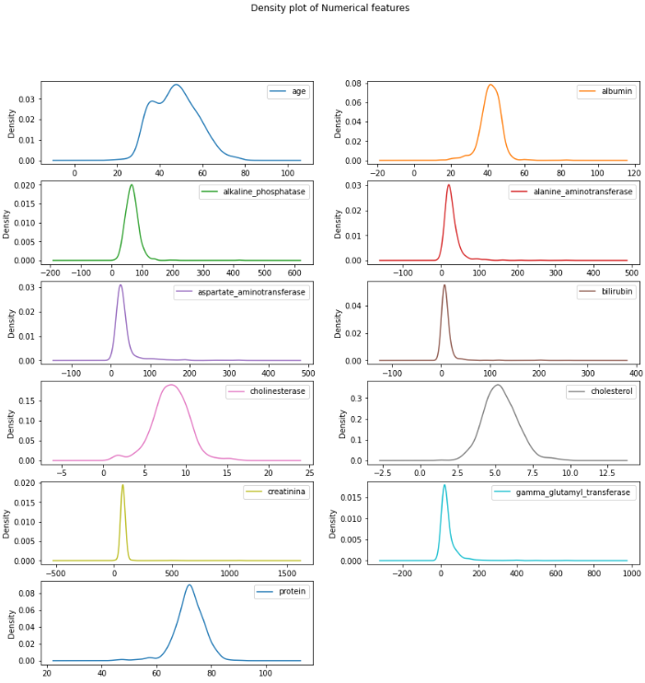
Density plot of Numerical features

Slide 18
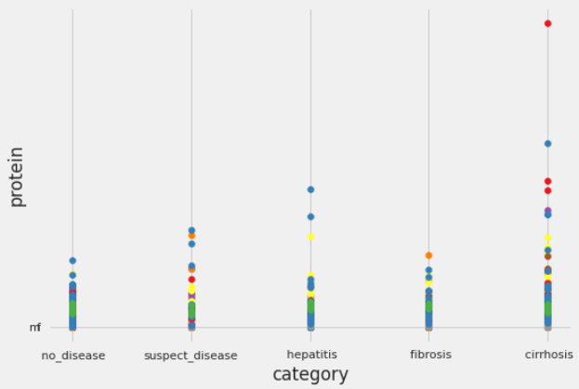
multiple scatterplots

Slide 19
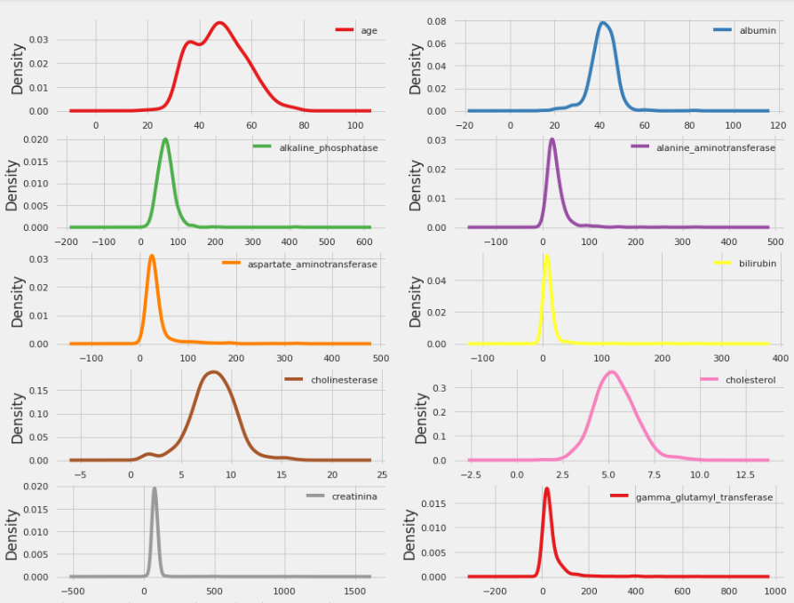
Density plot of Numerical features

Slide 20
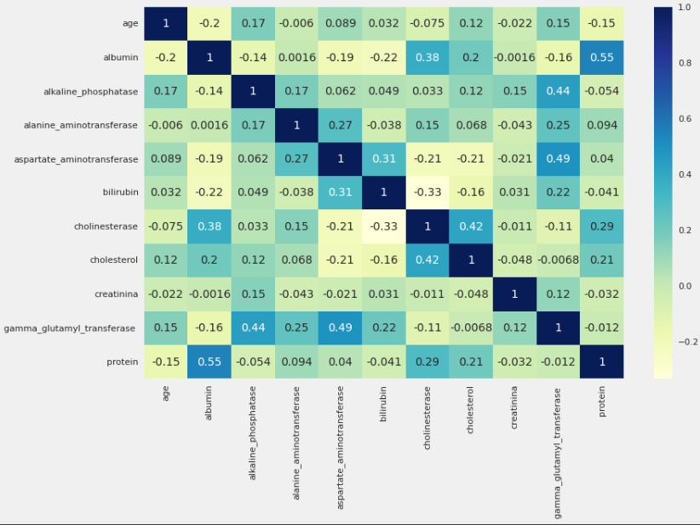
Multicolinearity detection and treatment

Slide 21
Multicolinearity detection and treatment
Usually we drop that feature which has above 0.85% multicollinearity between * List item
* List item two independent feature. but there are no one here

Slide 22
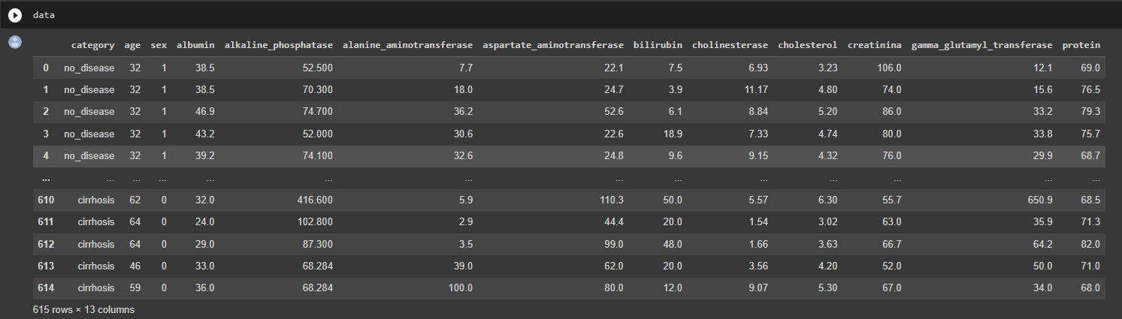
Feature Importance by random forest

Slide 23
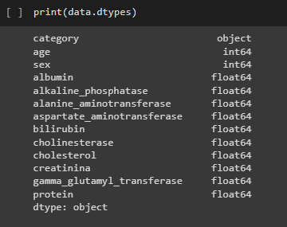
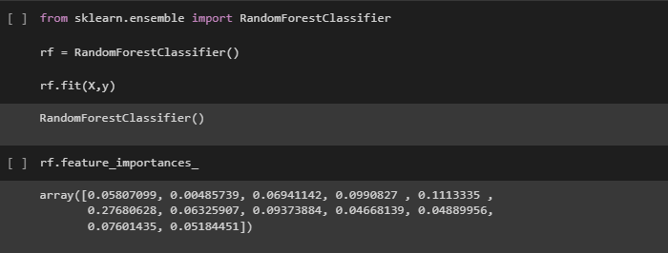
Data Type

Slide 24
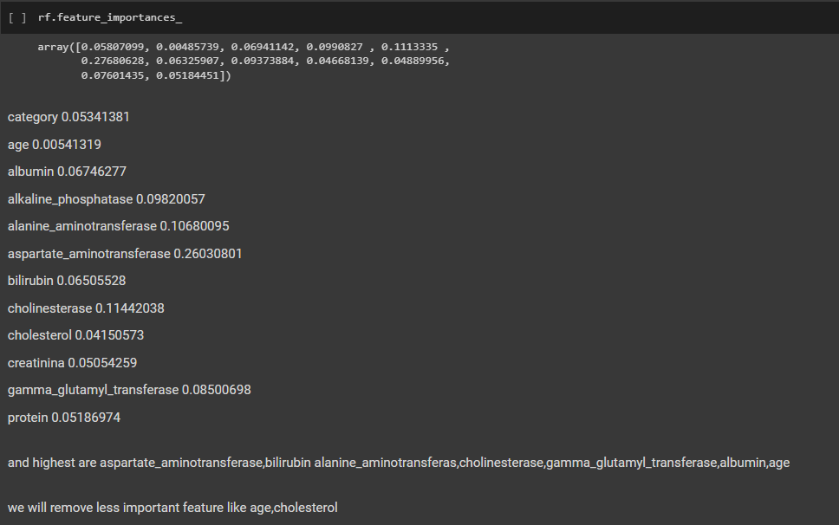
Feature Importance

Slide 25
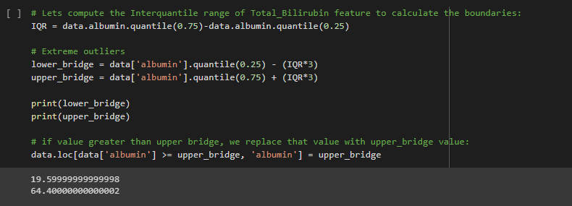
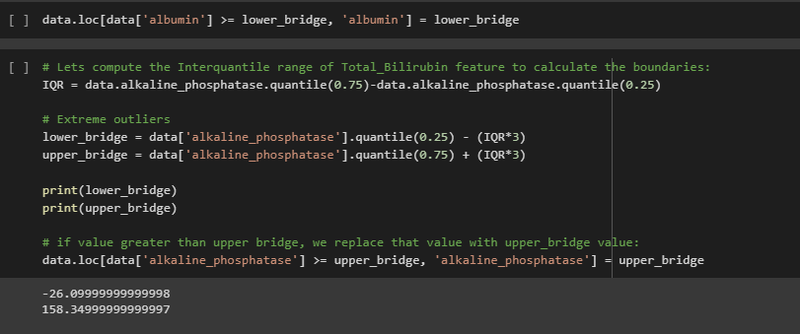
Outlier detection and Handling

Slide 26
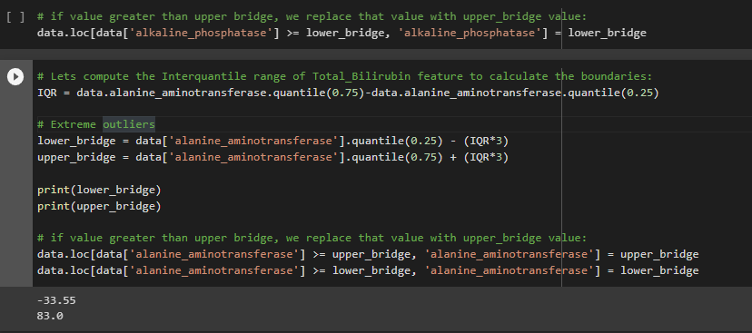
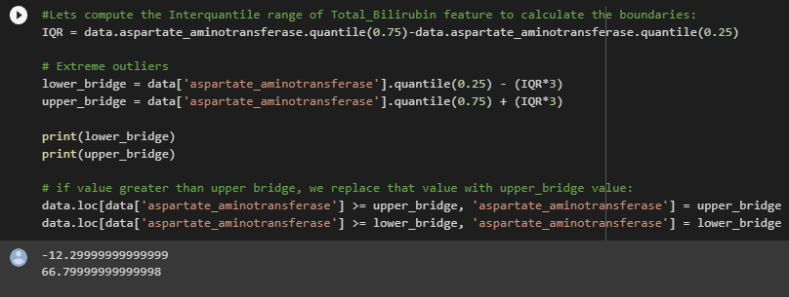

Slide 27
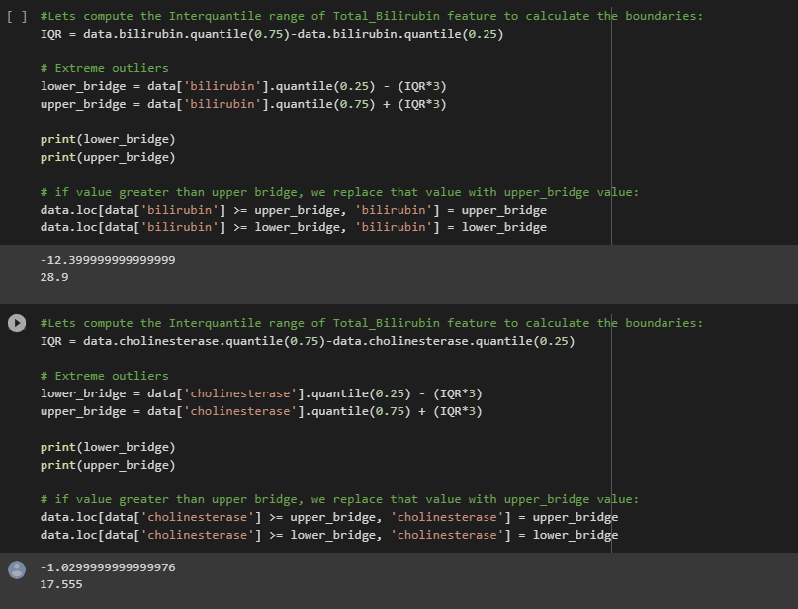

Slide 28
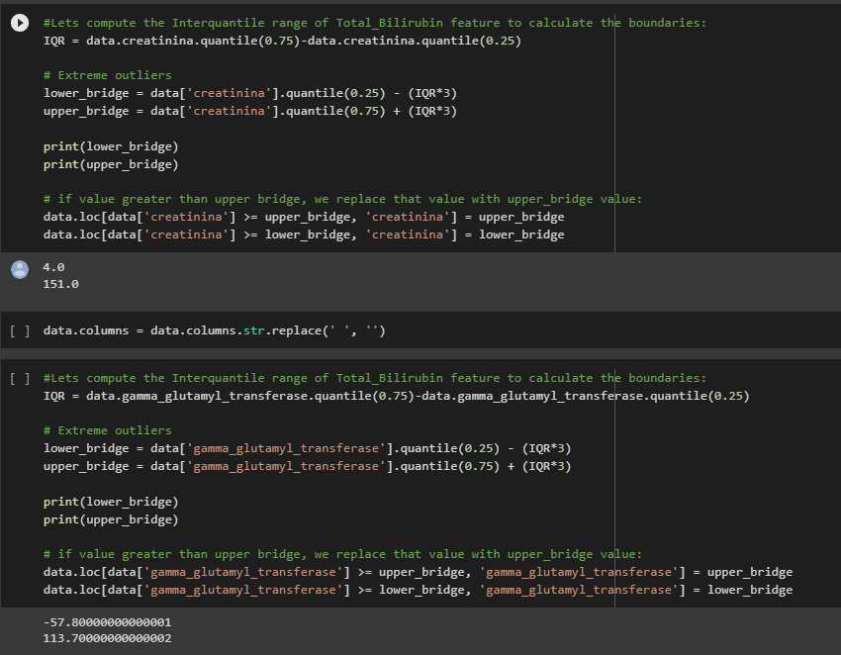

Slide 29
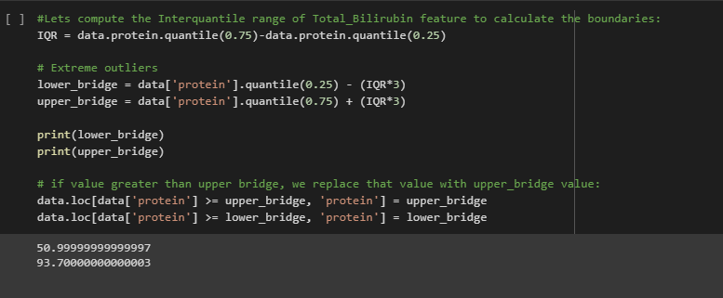

Slide 30
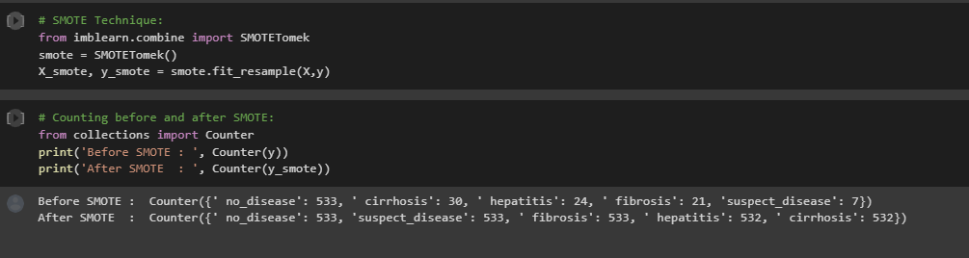
Data Balancing

Slide 31
Model Building

Slide 32
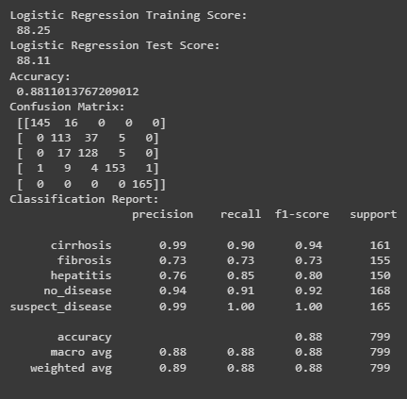
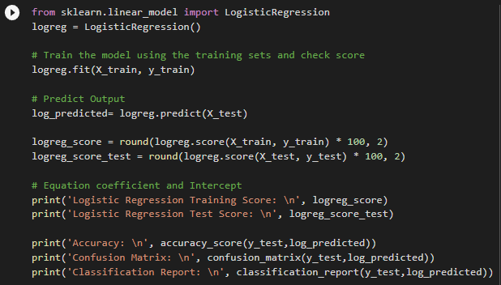
Logistic Regression

Slide 33
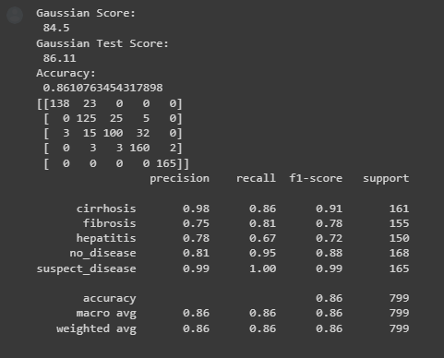
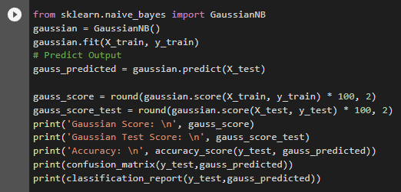
Gaussian Naïve Bayes

Slide 34
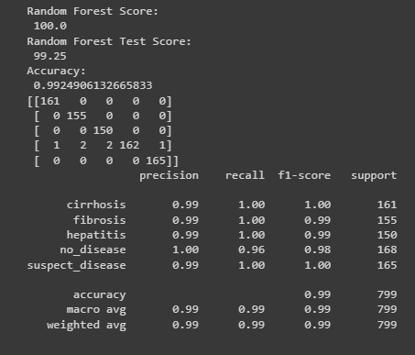
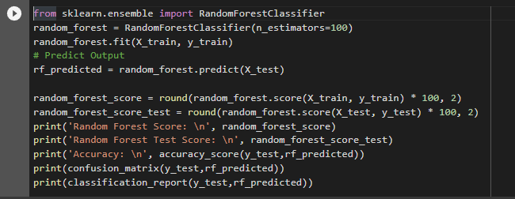
Random Forest Classifier

Slide 35
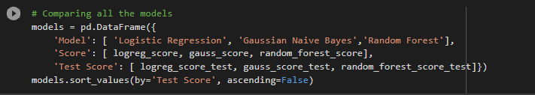
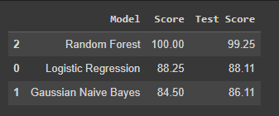
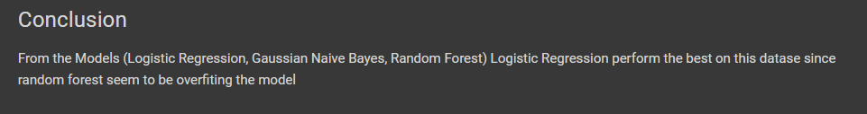
Model Evolution

